Slide 1


HUGGING FACE REASONING LLMS: A GUIDE TO MODEL SELECTION & LEADERBOARD INSIGHTS

Slide 2


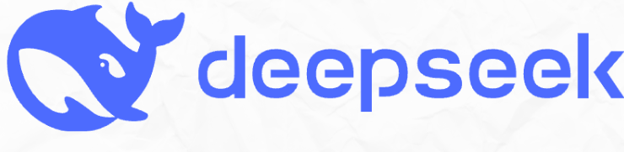

Project Overview
In this project, we will explore the power of reasoning models such as Deepseek to perform sentiment analysis on news data and classify them with reason.
Model Output
REASONING: The report shows a significant increase in employment, which is supported by a very low unemployment rate, indicating a positive sentiment.
SENTIMENT: Positive
TAG: Employment
News Data
Title: Jobs report shows increase of 517,000 in January as unemployment rate hits 53-year low.
Description: Nonfarm payrolls were expected to increase by 187,000 in January.
© All rights reserved for Dr. Ryan Ahmed @Stemplicity Inc.
Reason: Okay, so I'm trying to figure out how to analyze this news text. The title is about Jobs' report showing a rise of 517,000 in January, which is a big increase.
The user wants me to analyze this and output only the three requested items: reasoning, sentiment, and tag.
First, the reasoning part. I need to explain why the sentiment is positive or negative. Since Jobs' report showed a significant increase in employment, and the unemployment rate is very low, it makes sense that the overall sentiment would be positive.
I should double-check to make sure I'm not missing anything. The reasoning seems solid, the sentiment is clear, and the tag is concise. I think that covers everything the user asked for.

Slide 3

Key Learning Outcomes
Work with reasoning LLMs, such as DeepSeek, that require logical, step-by-step thinking and understand how these models differ from general-purpose chatbots.
Explore how to use the Hugging Face datasets library to efficiently load, preprocess, & manage datasets from the Hub.
Develop prompting strategies for structured responses that guide models to generate outputs in a specific format (e.g., reasoning steps followed by classification).
Gain skills in parsing model outputs to extract relevant elements, such as intermediate reasoning & final answers, from generated text.
Apply LLMs to classification tasks that are typically handled by traditional classifiers, with the added advantage of greater transparency and explainability.
Learn how to navigate Hugging Face leaderboards to evaluate the performance of open- and closed-source models.
Apply a framework to choose the right LLM for your business.
© All rights reserved for Dr. Ryan Ahmed @Stemplicity Inc.

Slide 4
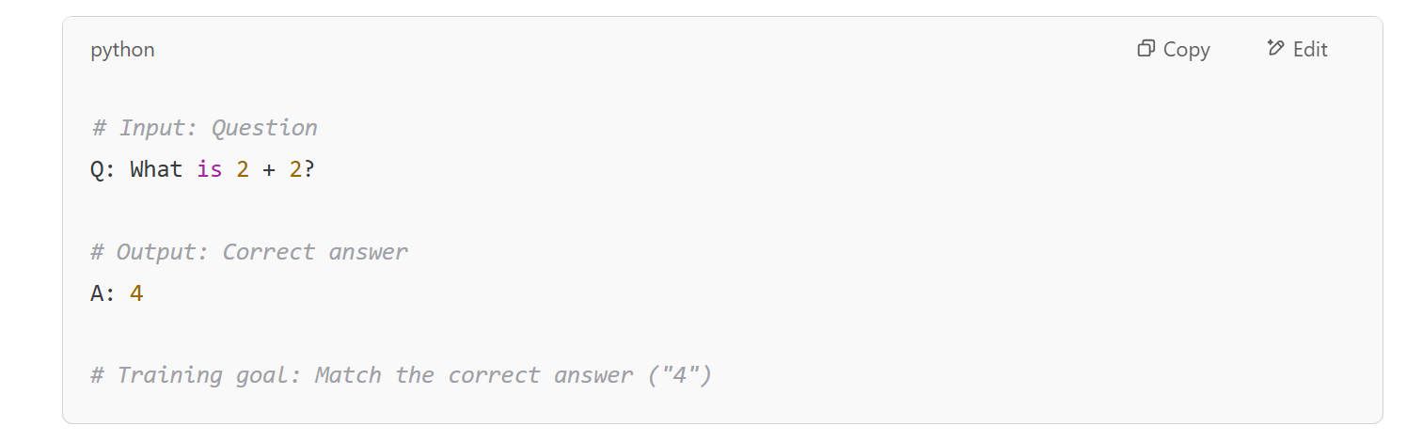
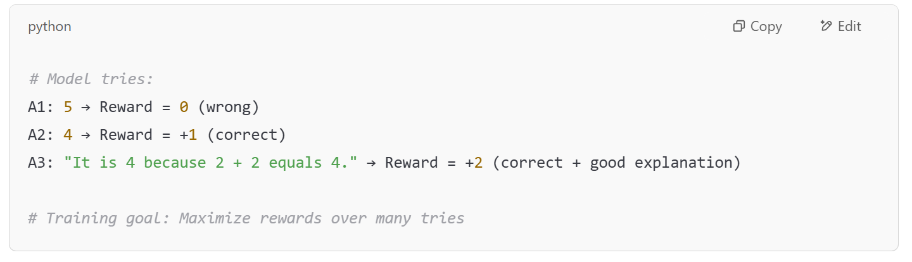
DeepSeek Models: RL Vs. SFT
Unlike OpenAI’s GPT models, which typically rely on supervised fine-tuning (SFT) before reinforcement learning (RL), DeepSeek models take a different path.
They apply RL directly to the base model without using SFT as a starting point.
This unique training strategy enables the model to naturally develop advanced reasoning skills, such as chain-of-thought reasoning, self-verification, & reflection. As a result, DeepSeek models generate more thoughtful, step-by-step solutions to complex problems, representing a significant breakthrough in the field of AI.
Supervised Fine-Tuning (SFT)
We give the model a question and the correct answer, and the model learns from labelled examples.
Reinforcement Learning (RL)
We let the model try answering without telling it the right answer upfront. The model gets a reward based on how good the answer is. It learns from trial & error, improving over time.
© All rights reserved for Dr. Ryan Ahmed @Stemplicity Inc.

Slide 5
A FRAMEWORK TO CHOOSE THE RIGHT MODEL FOR BUSINESSES

Slide 6
Steps to Choose the right LLM for your application
1. Define your needs
3. Choose the right-sized model
4. Select the LLM Sourcing options (Open Vs. Closed Source)
2. Choose the model Type (you might not need generative AI!)
5. Decide how the solution scales
© All rights reserved for Dr. Ryan Ahmed @Stemplicity Inc.

Slide 7

Step 1. Define Your Needs
The first step is for leadership to identify the specific problem they want to solve.
Key Questions to Ask:
What is the core task? (e.g., summarization, classification, search, generation)
Do you want to improve business intelligence with an AI Chatbot?
Do you want to enhance search capabilities within enterprises with AI?
What is the expected input and output?
Are there data privacy, latency, time to market, build cost constraints, or inference cost constraints?
© All rights reserved for Dr. Ryan Ahmed @Stemplicity Inc.

Slide 8
Step 2. Choose the Right Model Type
Select the appropriate AI Model Type. Not every problem needs a generative LLM.
Model Type | Purpose | Example Use Cases | Do You Need a Generative LLM?
Classification | Assign a label or category to input text | Spam detection, sentiment analysis | ❌ No
Named Entity Recognition | Extract specific entities from text | Extracting names from contracts | ❌ No
Retrieval-Based | Return relevant documents or responses | Internal knowledge base search | ❌ No (can be enhanced with LLMs)
Summarization | Condense long text into shorter versions | Legal documents summarization | ✅ Often yes
Text Generation | Create new content from scratch | Email drafting, creative writing | ✅ Yes
Code Generation | Generate code snippets from prompts | Developer tools, SQL query assistants | ✅ Yes
Translation | Convert text from one language to another | Multilingual support systems | ✅ Yes
Conversational Chatbots | Maintain a dialogue with users | Customer support & virtual assistants | ✅ Yes
Reasoning | Reasoning ability | Provides an explanation for decisions | ✅ Yes
© All rights reserved for Dr. Ryan Ahmed @Stemplicity Inc.

Slide 9
Step 3. Choose the Right Model Size
LLMs vary in size depending on the number of parameters (weights) they contain.
Category | Small / Medium LLM (e.g., <50bn parameters) | Large / Extra-Large LLM (e.g., >50bn parameters)
Performance | Low Can be improved with fine-tuning | High Can achieve better accuracy
Cost of inference | Low More economical to scale | High More expensive to run
Latency | Low Faster generations suitable for interactive applications | High Slower generations due to more compute required for the larger number of parameters
Knowledge | Low May not perform as well with deeper level of tasks, but can be optimized with RAG | High Can capture more information and variety of tasks
Understanding | Low Lacks in tasks that require complex reasoning | High Better at understanding context for complex reasoning
Environmental impact | Low Consumes less, lower carbon-footprint | High Consumes more, higher carbon-footprint
Deployment complexity | Low Fast and easier to deploy and integrate, especially on edge devices. More accessibility to a broader set of accelerators | High Harder to deploy and maintain, requiring a higher level of expertise to manage. Tends to require large and new generation accelerators.
© All rights reserved for Dr. Ryan Ahmed @Stemplicity Inc.
Source https://cohere.com/blog/how-to-choose-the-right-ai-model-for-your-enterprise

Slide 10
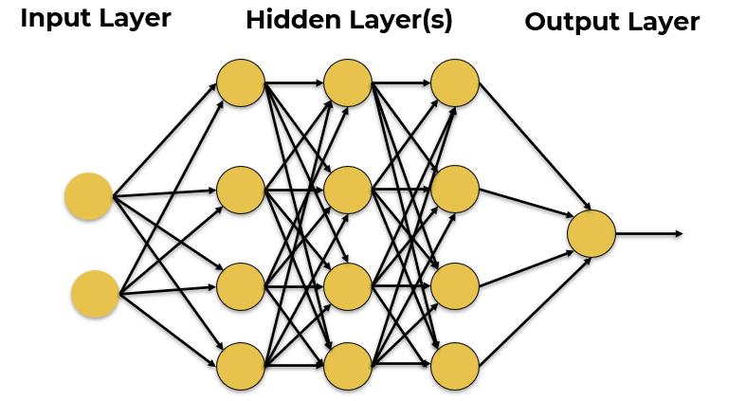



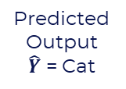
Step 3. Choose the Right-Sized Model (AI Basics Recap)
Training Dataset
Inputs
Predicted
Output
$\hat{Y}$ = Cat
Desired Output $Y$
Label = Dog
© All rights reserved for Dr. Ryan Ahmed @Stemplicity Inc.
Error = $\hat{Y}−Y$
Update Network Weights
Photo Credit: https://commons.wikimedia.org/wiki/File:My_dog.jpg

Slide 11
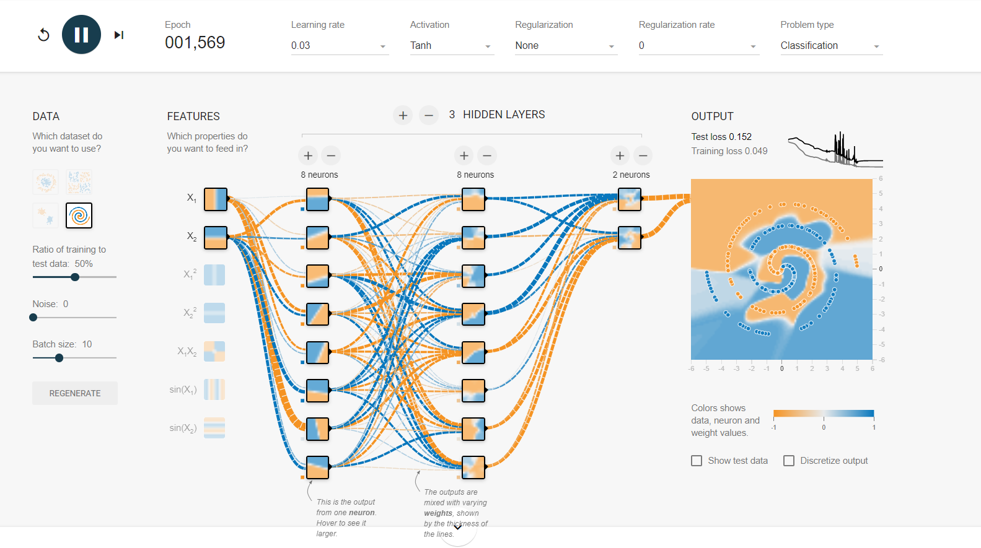
Step 3. Choose the Right-Sized Model (AI Basics Recap)
https://playground.tensorflow.org/
GPT-3
175,000,000,000
© All rights reserved for Dr. Ryan Ahmed @Stemplicity Inc.
GPT-4
100,000,000,000,000

Slide 12
Step 4. Select the LLM Sourcing Options
1. Develop an LLM from scratch in-house, utilizing either on-premises or cloud computing resources (GPT-3 costs ~$100M).
2. Choose pre-trained, open-source LLMs available in the market (Hugging Face).
3. Employ pre-trained, proprietary LLMs through various cloud services or platforms.
Businesses have three options to source LLMs:
© All rights reserved for Dr. Ryan Ahmed @Stemplicity Inc.

Slide 13
Step 4. Select the LLM Sourcing Options
You might be thinking, open source makes sense, of course! Well, it’s not that simple!
Category | Open-Source LLM | Proprietary LLM
Cost | Free/low cost, but estimates claim deployment costs can be 50-100% higher. | Requires subscription or usage fees. Most offer free trials.
Time-to-solution | High time-to-solution since it requires additional expertise to integrate the models to solve for a specific use case. | Low time-to-solution due to integrated offerings tailored to solve enterprise use cases.
Data provenance and indemnity | Lack of transparency into the data used to train the models make it harder to use in applications. | Rigorous checks on source data ensure compliance satisfaction to a high standard.
Support and updates | Community-based support. Updates may be irregular. | Professional onboarding support and deployment engineers are available.
© All rights reserved for Dr. Ryan Ahmed @Stemplicity Inc.

Slide 14
Step 5. Decide how the solution scales
To shift from proof of concept (POCs) to full production, businesses need to understand how scaling LLM applications impacts costs, performance, and ROI.
Requirements: Consider data residency requirements. Some countries require that data collected locally must also be stored locally. Knowing this will help you decide between a multi-tenant, hosted, API-based solution.
Scope: Estimate your expected data volume and traffic. Many hosted APIs impose rate limits, which can affect user experience and system performance.
Skills: Identify the skills needed for your preferred solution, from prompt engineering to full model training. You may need a mix of upskilling and new hires depending on the complexity.
Costs: Assess the end-to-end costs of different approaches. Retrieval-augmented generation (RAG) models are ideal for frequently changing data but require maintaining a search system. Fine-tuning demands upfront investment but can deliver long-term savings.
Operations: Evaluate your operational capabilities, including cost and technical expertise, to decide between in-house deployments or managed services like AWS Bedrock.
© All rights reserved for Dr. Ryan Ahmed @Stemplicity Inc.

Slide 15
LEADERBOARDS FOR OPEN-SOURCE MODELS & COMMON BENCHMARKS

Slide 16
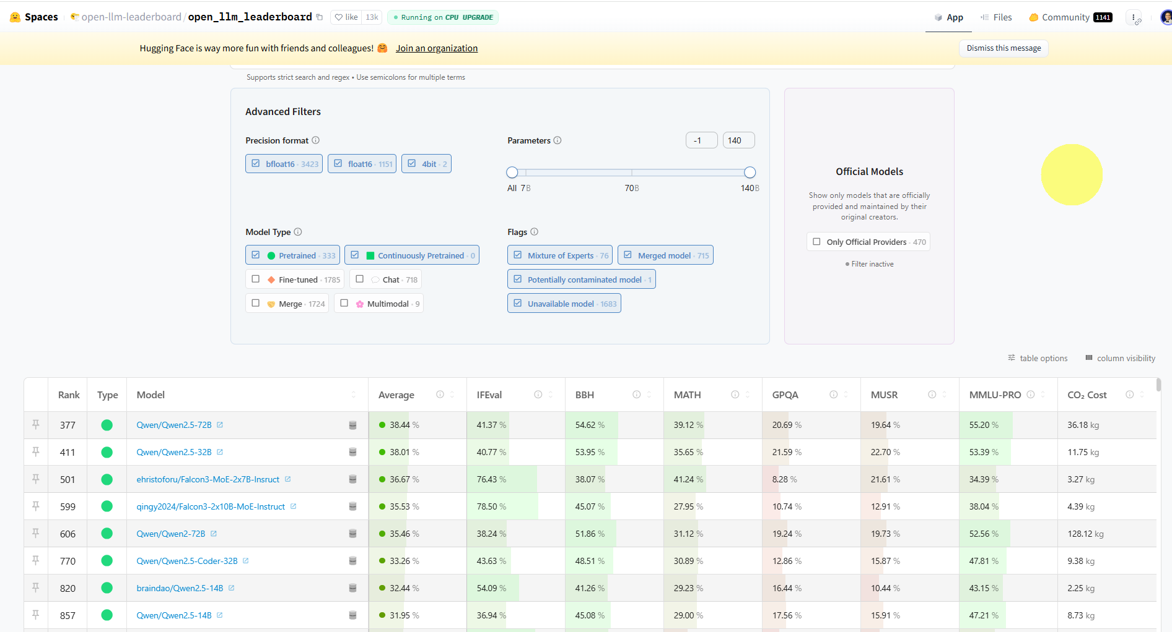
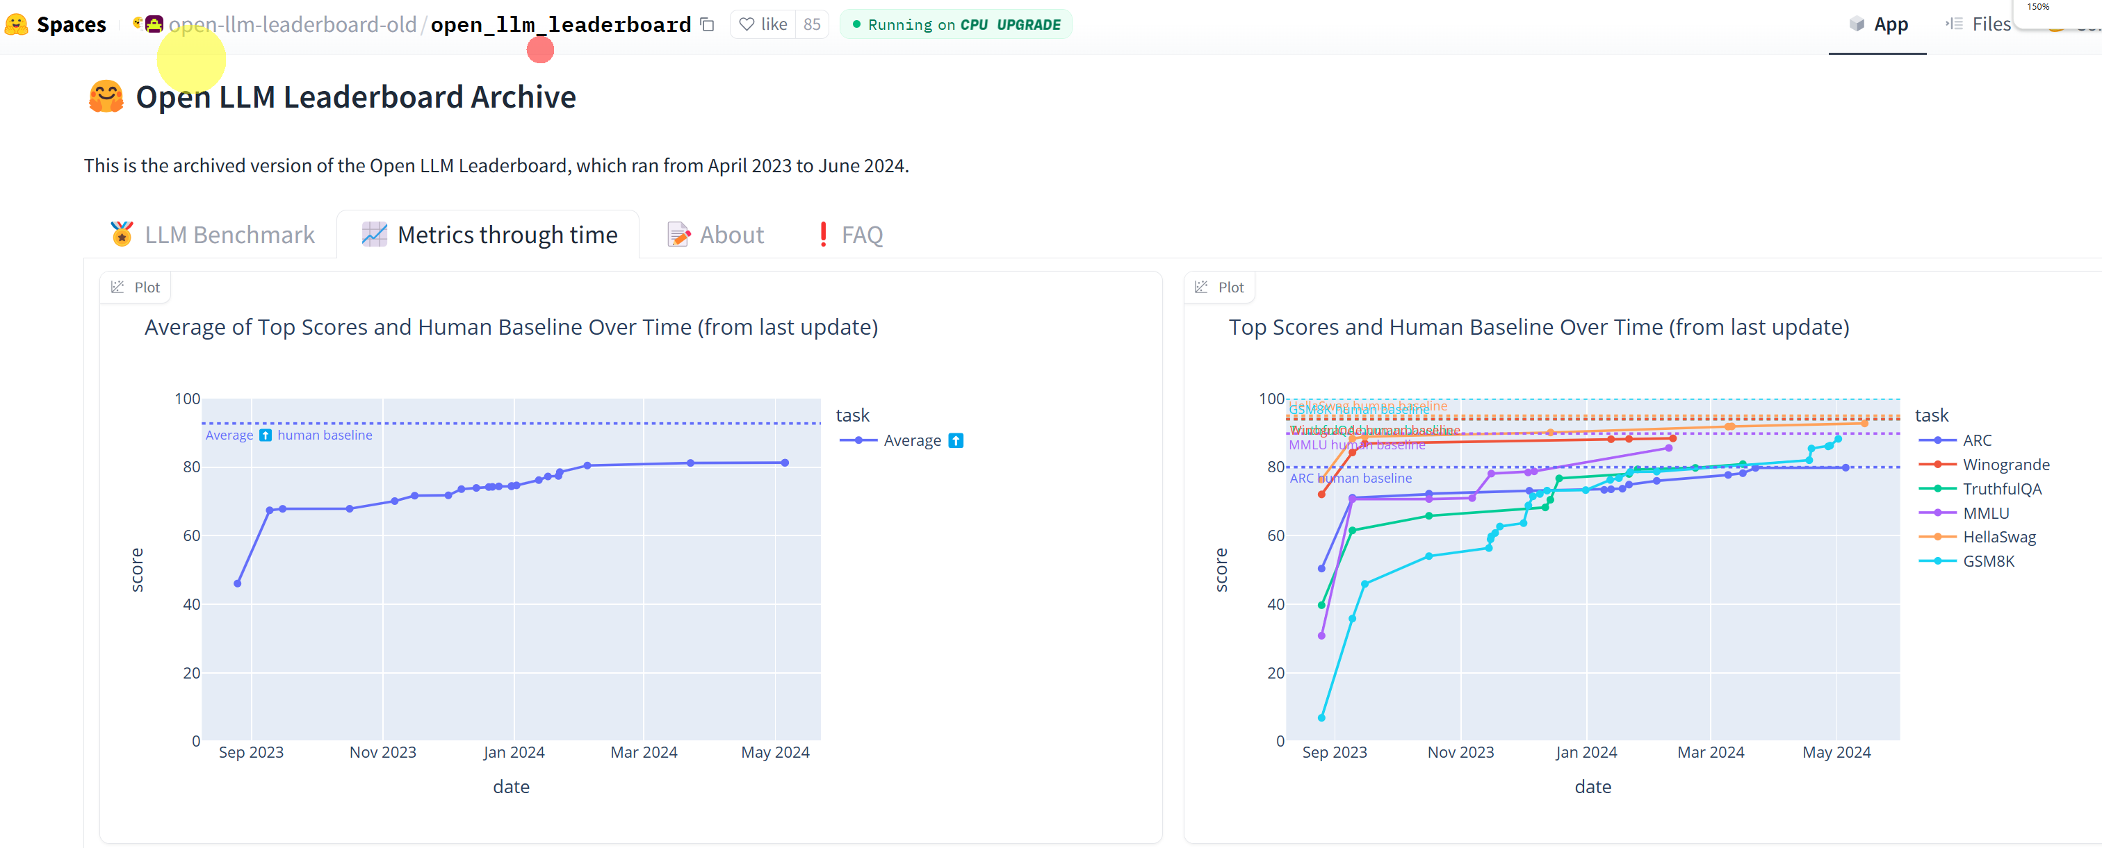
Hugging Face Leaderboard (Open-Source Models)
Old Leaderboard: https://huggingface.co/spaces/open-llm-leaderboard-old/open_llm_leaderboard
New Leaderboard: https://huggingface.co/spaces/open-llm-leaderboard/open_llm_leaderboard#/
© All rights reserved for Dr. Ryan Ahmed @Stemplicity Inc.

Slide 17
Common Benchmarks to Compare LLMs
Benchmark | Full Name | Skill Evaluated | Purpose / Description
DROP | Discrete Reasoning Over Paragraphs | Reading Comprehension | Evaluates the ability to extract, count, and manipulate information from paragraphs.
HellaSwag | Harder Endings, Longer Contexts, Low Shot Activities | Common Sense | Assesses common sense reasoning with complex, nuanced scenarios.
MMLU | Massive Multitask Language Understanding | Understanding | Covers factual recall & problem-solving across 57 academic subjects.
ARC | AI2 Reasoning Challenge | Logical Reasoning | Tests scientific and abstract reasoning through multiple-choice questions.
TruthfulQA | Truthful Question Answering | Truthfulness and Robustness | Measures a model's ability to resist producing false or misleading answers.
Winogrande | A variant of the Winograd Schema Challenge | Context | Tests whether the model resolves ambiguities in sentence structure.
GSM8K | Grade School Math 8K | Math Problem Solving | Focuses on solving grade-school-level math.
HumanEval | Human Evaluation of Code Generation | Code Generation | Evaluates coding abilities by generating code from problem descriptions.
MT-Bench | Multi-Turn Benchmark | Dialogue Quality | Assesses multi-turn conversation quality, coherence, and helpfulness.
© All rights reserved for Dr. Ryan Ahmed @Stemplicity Inc.
DROP Research Paper: https://arxiv.org/abs/1903.00161
HellaSwag Research Paper: https://arxiv.org/abs/1905.07830

Slide 18
New (Harder) Benchmarks for LLMs & AI Agents
Benchmark | Category | What it tests?
HLE (Humanity’s Last Exam) | LLM | 2,500 challenging questions handcrafted to challenge superintelligence-level generalization
GPQA | LLM | Graduate-Level Google-Proof Q&A (GPQA) features PhD-level multiple-choice questions in Chemistry, Biology, and Physics designed to test deep conceptual understanding beyond simple online searches (Google Proof!).
MuSR | LLM | Multistep Soft Reasoning (MuSR) focuses on reasoning through and understanding long texts, emphasizing deep language comprehension.
BBH (Big-Bench Hard) | LLM | Big Bench Hard (BBH) is a collection of challenging tasks for LLMs across domains such as language understanding, mathematical reasoning, and common sense/world knowledge.
IFEval | LLM | Instruction-Following Evaluation (IFEval) tests a model’s ability to follow explicit instructions related to formatting, instruction compliance, and content generation.
MATH | LLM | Mathematics Aptitude Test of Heuristics (MATH), level 5. It includes hard math competition-level questions
MMLU-Pro | LLM | Massive Multitask Language Understanding - Professional (MMLU-Pro) features expertly reviewed multiple-choice questions across diverse domains such as medicine, law, engineering, and mathematics.
AgentBench | AI Agent | Multi-step digital tasks requiring memory and reasoning
WebArena | AI Agent | Real-time web browsing, unexpected layouts
ToolBench | AI Agent | Tool chaining, decision making
CO₂ Cost | Meta | Useful for sustainability evaluation of different models
© All rights reserved for Dr. Ryan Ahmed @Stemplicity Inc.

Slide 19
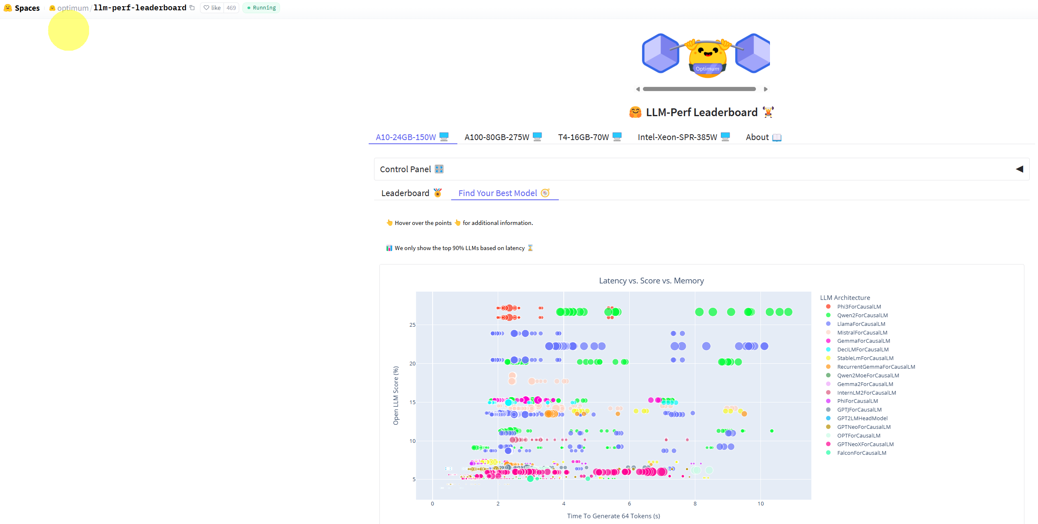
Performance Leaderboard
Performance Leaderboard: https://huggingface.co/spaces/optimum/llm-perf-leaderboard
© All rights reserved for Dr. Ryan Ahmed @Stemplicity Inc.

Slide 20
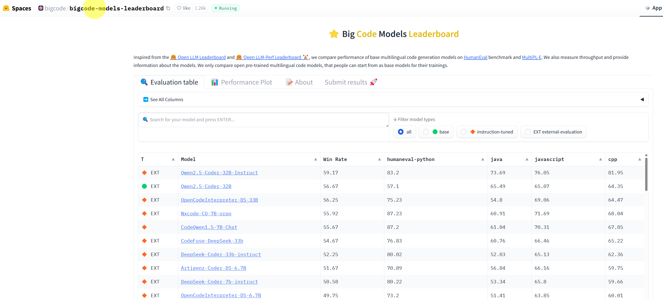
Coding Leaderboard
Big Code Models Leaderboard: https://huggingface.co/spaces/bigcode/bigcode-models-leaderboard
© All rights reserved for Dr. Ryan Ahmed @Stemplicity Inc.

Slide 21
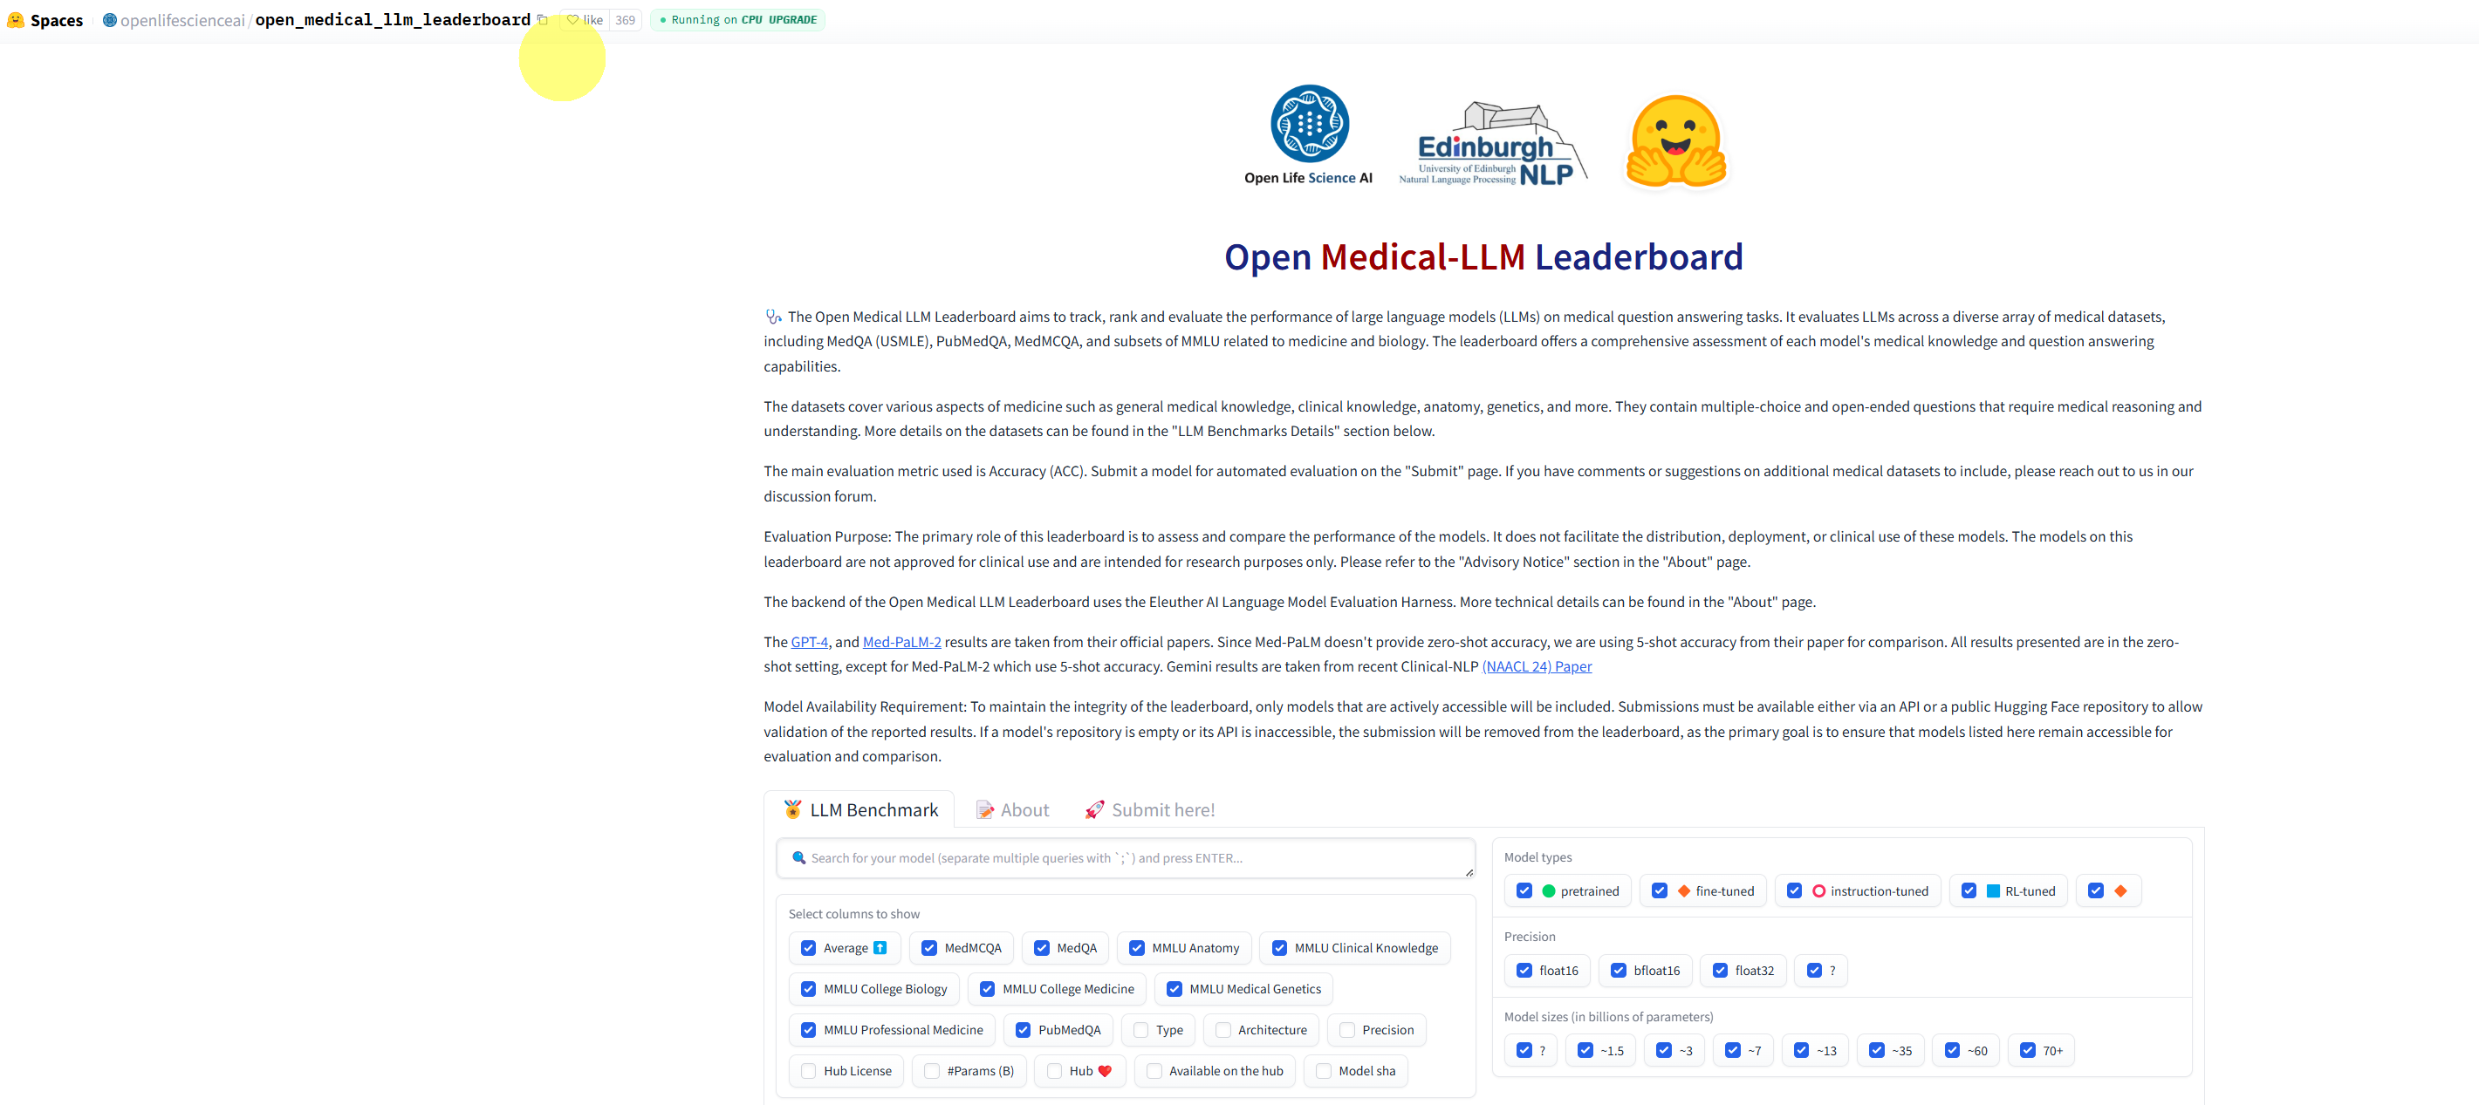
Open Medical-LLM Leaderboard
https://huggingface.co/spaces/openlifescienceai/open_medical_llm_leaderboard
© All rights reserved for Dr. Ryan Ahmed @Stemplicity Inc.

Slide 22

Summary
Not all LLMs are created equal; models like DeepSeek require structured, logical thought processes and differ significantly from general-purpose conversational models. It's important to assess your use case and match it with the appropriate model type.
Efficient use of the Hugging Face datasets library can greatly streamline the data workflow; loading, preprocessing, and managing data becomes much easier and standardized for downstream tasks.
Crafting clear, goal-driven prompts that enforce output structure (e.g., reasoning then classification) enhances model reliability and interpretability.
Being able to dissect the model's output to separate reasoning steps from final answers is a critical skill for tasks requiring auditability or deeper analysis of model behavior.
Using LLMs for classification introduces a layer of explainability not always present in traditional classifiers. This enables users to understand why a decision was made, not just what the decision is.
Navigating leaderboards helps practitioners make informed decisions about which LLM to use based on performance benchmarks; especially when choosing between open- vs. closed-source solutions.
Implementing a structured approach to selecting the right model ensures alignment with specific business goals, resource constraints, and performance requirements.
© All rights reserved for Dr. Ryan Ahmed @Stemplicity Inc.

Slide 23
Thank you!

